Slide 1

New Student Onboarding
Year 9
2023 – 2024
Student Leadership Council

Slide 2
CBBG
NSF funded engineering research center (ERC)
Currently in Year 9, funded through Year 10
Partner universities: ASU (lead), GT, NMSU, and UCD plus collaborations with other undergraduate institutions
People:
Ed Kavazanjian, Center Director
Claudia Zapata, Deputy Director
Charlotte Bowens, Administrative Director (Charlotte.Bowens@asu.edu)

Slide 3
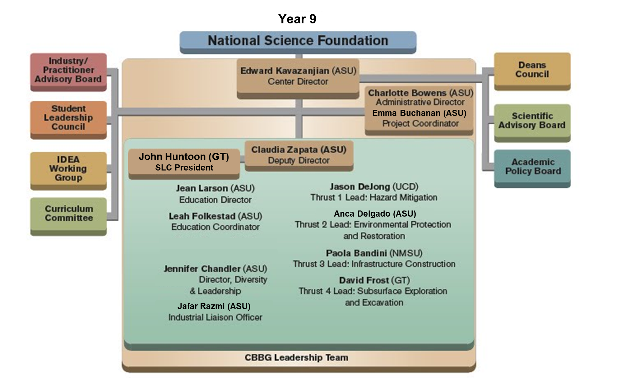
CBBG Objectives
Develop bio-based or bio-inspired technologies for sustainable and resilient infrastructure development and rehabilitation
Establish biogeotechnics as a recognized sub-discipline
Inspire a new, diverse generation of geo-professionals

Slide 4
Groups and Programs
Groups:
IDEA Working Group – Innovation, Diversity, and Education Activities
https://cbbg.engineering.asu.edu/diversity-inclusion/
Science Advisory Board (SAB) – researchers and faculty members
Industry Advisory Board (IAB) – representatives of industry partners
Programs:
Young Scholars Program (YSP): mentored research experience for high school students to experience university research
https://cbbg.engineering.asu.edu/education/young-scholars-program/
Research Experience for undergraduate (REU): mentoring program for visiting undergrads over the summer at each collaborating institution
https://cbbg.engineering.asu.edu/education/research-experience-for-undergraduates/
Research Experience for Teachers (RET): program for K-12 teachers and community college faculty to participate in research and develop teaching plans which they will take back to their own classrooms
https://cbbg.engineering.asu.edu/education/research-experience-for-teachers/

Slide 5
Thrusts
Projects are organized by thrust:
Thrust 1: Hazard Mitigation (Jason DeJong, UCD)
Thrust 2: Environmental Protection and Ecological Restoration (Anca Delgado, ASU)
Thrust 3: Infrastructure Construction (Paola Bandini, NMSU)
Thrust 4: Subsurface Exploration and Excavation (David Frost, GT)
What is your thrust?

Slide 6
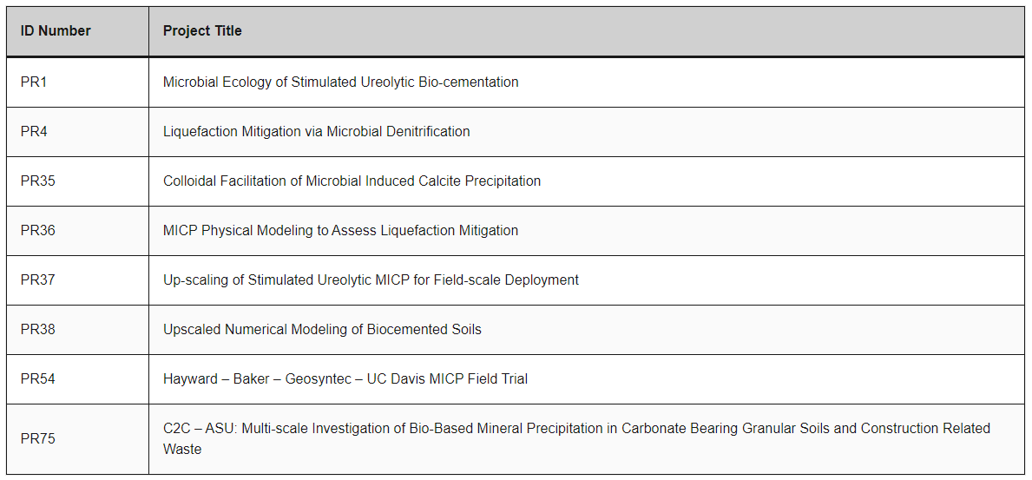
Thrust 1 – Hazard Mitigation
‹#›
Hazard Mitigation Faculty
Lead: Alejandro Martinez, UCD
R. Boulanger, UCD
S. Burns, GT
M. Gomez, UCD
E. Kavazanjian, ASU
N. Neithalath, ASU
D. Nelson, UCD
R. Parales, UCD
B. Rittmann, ASU
L. van Paassen, ASU
D. Wilson, UCD
C. Zapata, ASU
K. Ziotopoulou, UCD

Slide 7
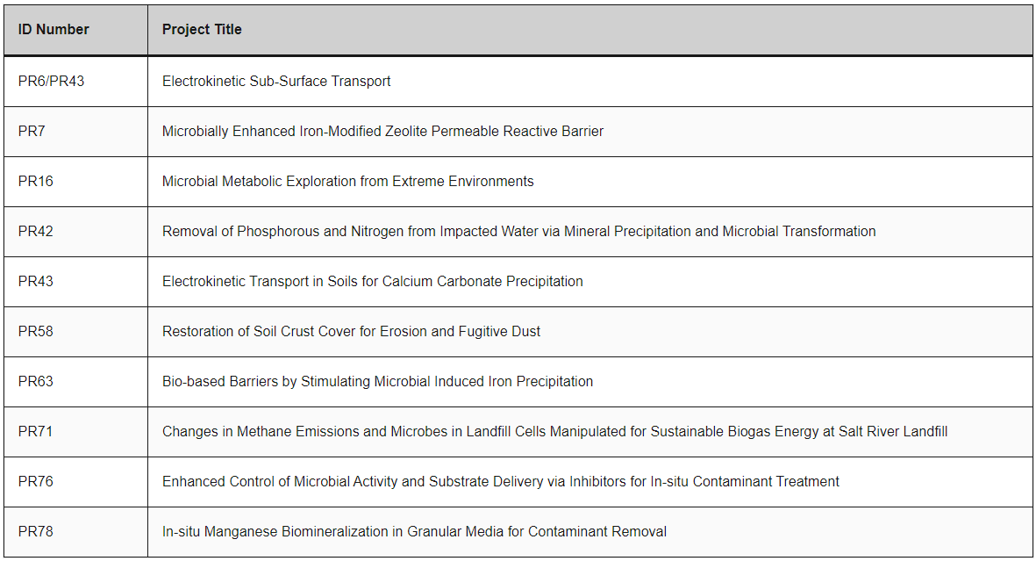
Thrust 2 – Environmental Protection and Restoration
‹#›
Environmental Protection And Restoration Faculty
Lead: A. Delgado, ASU
P. Bandini, NMSU
T. Boyer, ASU
H. Cadillo-Quiroz, ASU
A. Delgado, ASU
F. Garcia-Pichel, ASU
N. Hamdan, ASU
E. Kavazanjian, ASU
C. Papelis, NMSU
E. Shock, ASU
C. Torres, ASU
Y. Zhang, NMSU

Slide 8
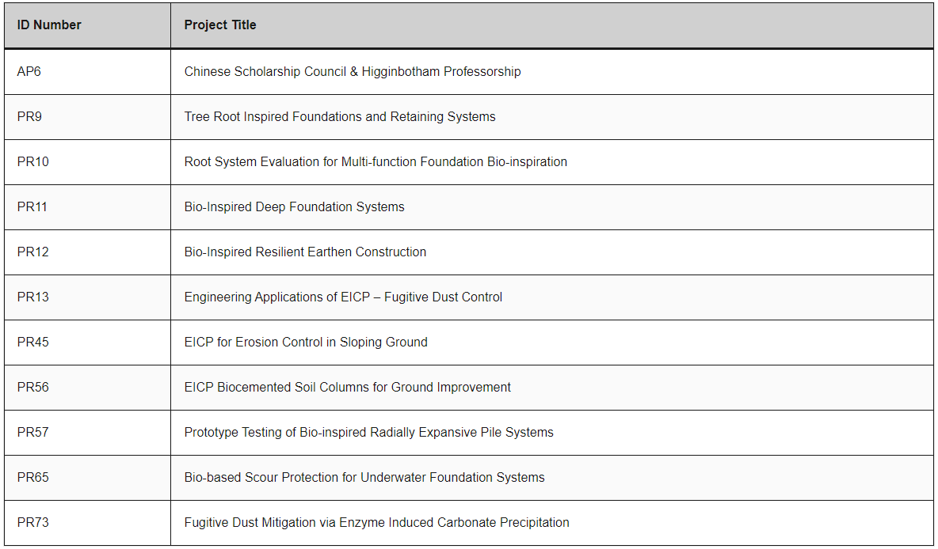
Thrust 3 – Infrastructure Construction
‹#›
Infrastructure Construction Faculty
Lead: P. Bandini, NMSU
L. Caslake, Lafayette
D. Cortes, NMSU
S. Dai, GT
J. DeJong, UCD
J.D. Frost, GT
N. Hamdan, ASU
E. Kavazanjian, ASU
H. Khodadadi, ASU
A. Martinez, UCD
M. McGinnis, UT Tyler
D. Nelson, UCD
C. Newtson, NMSU
R. Parales, UCD
M. Roth, Lafayette
L. van Paassen, ASU
E. Vivoni, ASU
B. Weldon, NMSU
D. Wilson, UCD
C. Zapata, ASU

Slide 9
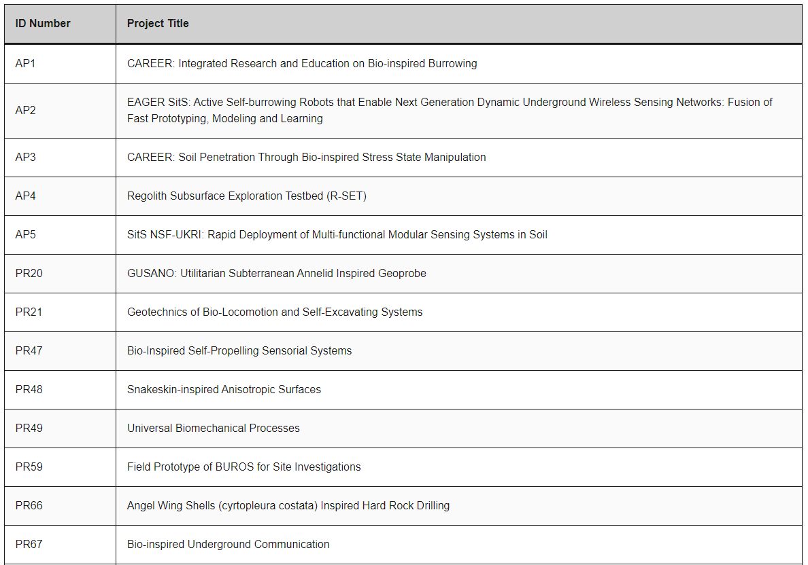
Thrust 4 – Subsurface Exploration and Excavation
‹#›
Subsurface Exploration & Excavation Faculty
Lead: J.D. Frost, GT
D. Aukes, ASU
D. Cortes, NMSU
S. Dai, GT
J. DeJong, UCD
D. Goldman, GT
A. Kendall, UCD
A. Martinez, UCD
H. Marvi, ASU
J. Tao, ASU
D. Wilson, UCD

Slide 10
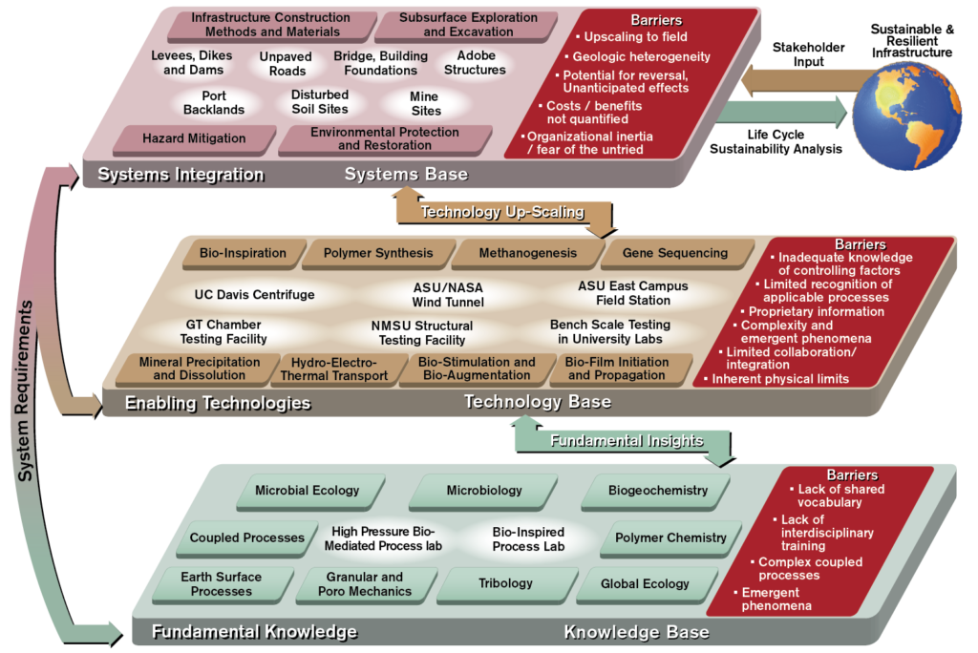

Slide 11
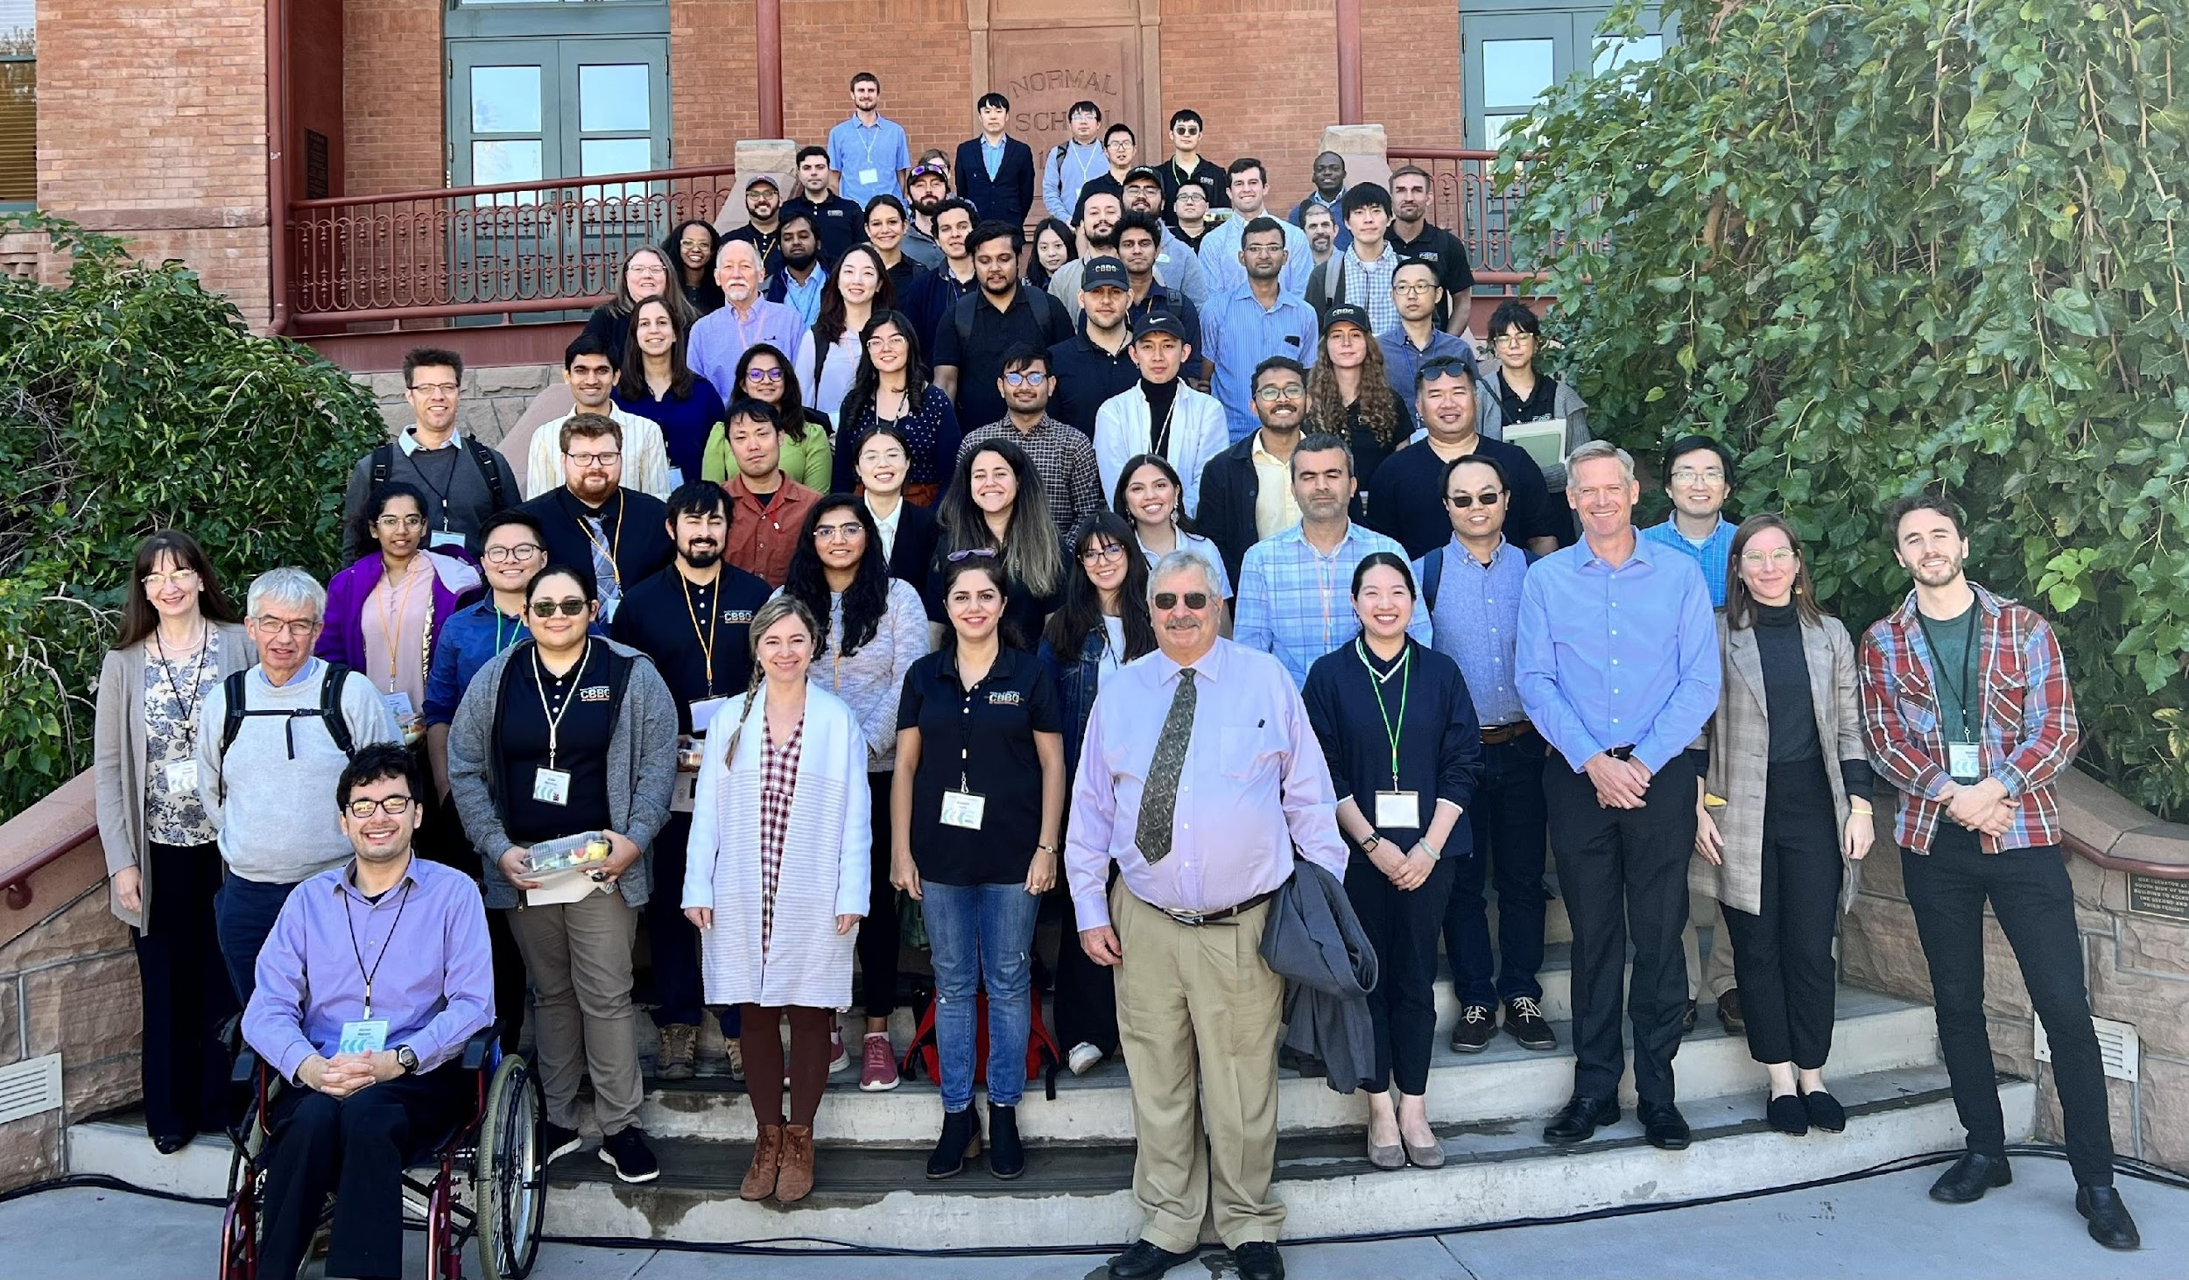
Meetings and Events
Annual Meeting (every October at ASU)
Site visit team (SVT) to evaluate CBBG’s progress
Thrust leaders presentations
Closed meetings with the center’s groups
SVT comments and questions
CBBG leadership answers
SVT report to CBBG leadership
SLC-organized student retreat and other social events
https://cbbg.engineering.asu.edu/news-and-events/site-visits/
Midyear Meeting (every April, rotation between partner universities)
Student presentations, barriers, training and workshops
SLC-organized student retreat and other social events
https://cbbg.engineering.asu.edu/news-and-events/cbbg-mid-year-meetings/
Webinars: all-year round
https://cbbg.engineering.asu.edu/webinar-series/

Slide 12
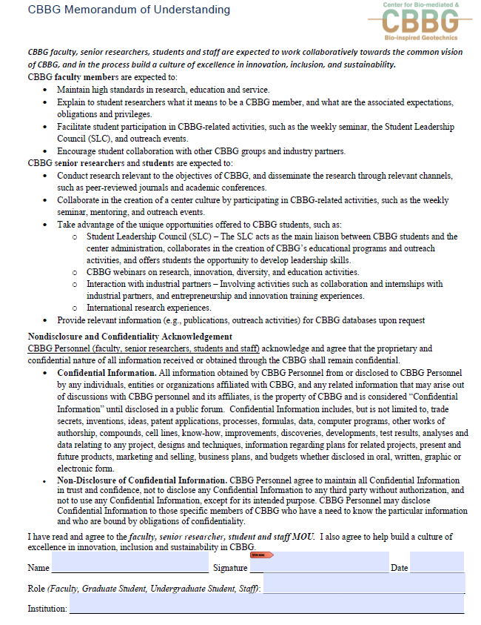
CBBG Onboarding
‹#›
Action Items
Onboarding Documents: https://cbbg.engineering.asu.edu/onboarding-documents/
Sign MOU (Memorandum of Understanding)
please sign and submit MOU to charlotte.bowens@asu.edu as soon as possible
https://drive.google.com/file/d/1JrqE4EM1Lx-X0LQXYMS8dscGixHzNu7k/view?pli=1
Sign Confidentiality Agreement
Connecting Research to the Broader Community Course – 1 Credit - Contact Jean Larson
Update database profile annually (~ each June).
https://cbbg.engineering.asu.edu/cbbg-database/
Complete Required Training
Lab safety, lab-specific, university-specific, etc.

Slide 13
CBBG Annual Expectations
‹#›
Participate in two outreach events: https://forms.gle/EeUTU6JUyH2Add128
lab tours, demos, K-12 school visits, etc.
Participate in SLC activities and student retreats
Join an SLC Committee Today
Social, Professional, Outreach, New Member Education
Committee Signup Sheet: https://docs.google.com/spreadsheets/d/1_A0jRY9E_ccodqEvCLSn8mYewqJIJkGJ7O7LqLltM_k/edit#gid=0
Participate in Perfect Pitch Competition
Update database profile: https://erc-cbbg.engineering.asu.edu/Account/Login?ReturnUrl=% Contact Leah Folkestad (folkestad@asu.edu) if issues continue
Complete SWOT survey (by SLC every Summer)
SWOT: Strengths, Weaknesses, Opportunities and Threats
Ask for students’ opinions on the center and the SLC’s operations
Survey results reviewed by SVT at Annual Meeting
Attend all mandatory webinars (diversity, mentoring, innovation, etc.)
Participate in the YSP, REU and/or RET programs

Slide 14

CBBG Expectations
Update database profile
Sign MOU every year
Mandatory participation in outreach events
lab tours, demos, K-12 school visits, etc.
at least 1 event per quarter or semester
Attend all mandatory webinars (diversity, mentoring, innovation, etc.) and elective webinars at leisure
Participate in the YSP, REU and/or RET programs
Participate in SLC activities and student retreats
March 3rd 2pm, Davis
Mandatory participation in yearly SWOT survey (by SLC every Summer)
SWOT: Strengths, Weaknesses, Opportunities and Threats
ask for students’ opinions on the center and the SLC’s operations
survey results reviewed by SVT at Annual Meeting

Slide 15
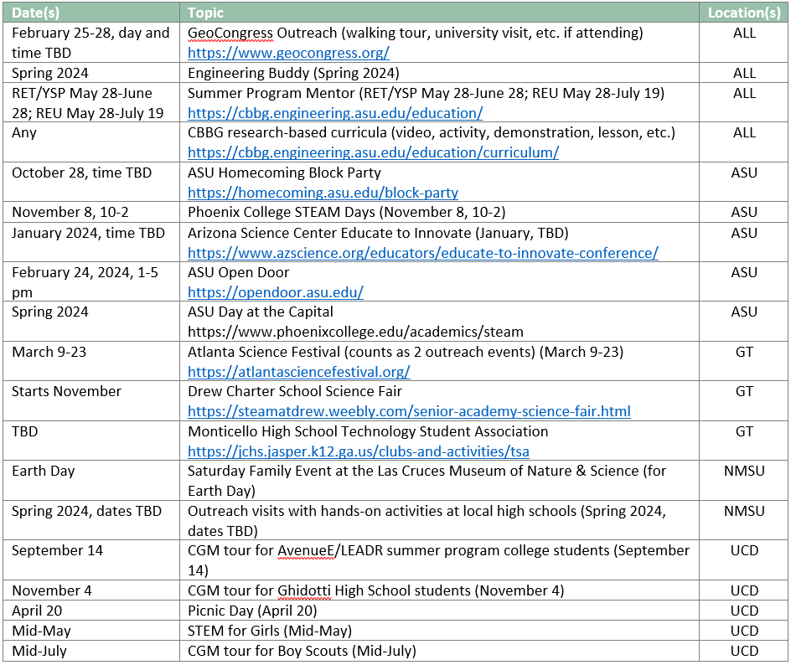
Outreach Opportunities
‹#›
SLC Outreach Committee Candas Oner - GT candasoner3@gatech.edu
Outreach Committee helps connect students with outreach events.

Slide 16
Perfect Pitch
‹#›
NSF organizes a “Perfect Pitch” competition for all ERCs.
“Perfect Pitch” is designed to help students improve their communication skills
90 Second “Pitch” of Research Topic or Idea
UCD’s Ella Fadely won 2nd place among all 15 ERC’s in 2022!
Link to Ella’s Perfect Pitch: https://youtu.be/75YHhf0p5L8?t=4976
$5,000 1st Prize!
Typical to use annual meeting poster or similar slide

Slide 17
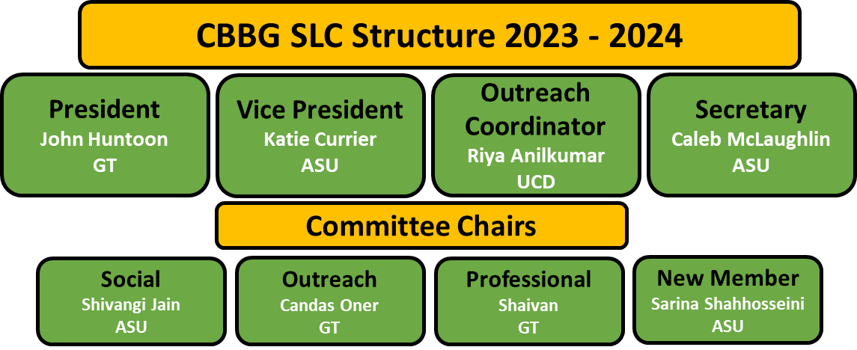
Student Leadership Council – Year 8
2023 CBBG Student List: https://docs.google.com/spreadsheets/d/1B1oPSaMuJu5faaf05YFeOBY_c31J-Ucp/edit#gid=814466659

Slide 18
CBBG Resources
BioGeotechNotes (every Tuesday) – news, reminders, announcements
NOT RECEIVING THEM? Email charlotte.bowens@asu.edu ??
Quarterly Newsletters – celebrate achievements, awards, events, etc.
https://cbbg.engineering.asu.edu/ (main CBBG website)
https://cbbgstudents.wordpress.com/ (student-driven blog)
https://cbbg.engineering.asu.edu/news-and-events/cbbg-templates/ (templates)
https://cbbg.engineering.asu.edu/about/cbbg-database/ (database)

Slide 19
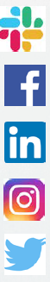
CBBG Online Presence
Slack – https://cbbg.slack.com/
Facebook – CBBG page (https://www.facebook.com/CBBGerc)
LinkedIn – CBBG group (https://www.linkedin.com/groups/13758579)
Instagram – @cbbg_erc (https://www.Instagram.com/cbbg_erc)
Twitter – @CBBGerc (https://twitter.com/CBBGerc)

Slide 20
SLC Plans for this year
‹#›
Social – Shivangi Jian (ASU): sjain89@asu.edu
Organize one CBBG student social event per campus
$2,000 available FOR EACH CAMPUS
Professional - Shaivan (GT): shaivan.hs@gatech.edu
Organize one industry outreach event per campus
Outreach – Candas Oner (GT): candasoner3@gatech.edu
Reduce percentage of students not participating in community outreach events
Make events more accessible and easier for students to participate in
New Member Education – Sarina Shahhosseini (ASU): sshahho1@asu.edu
Personally contact all new students and ensure they complete onboarding requirements before annual meeting
Compile resource package for students and send it out monthly to students

